Slide 1

Juniors Level 1

Slide 2
اللهم اجعل هذا العمل خالصا لِوَجْهِكَ الكريم

Slide 3
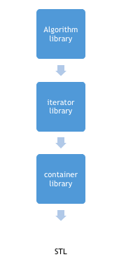
Standard Template Library
STL is an acronym for standard template library. It is a set of C++ template classes that provide generic classes and function that can be used to implement data structures and algorithms STL is mainly composed of :
Containers
Algorithms
Iterators

Slide 4
C++: Containers in STL
Container library in STL provide containers that are used to create data structures like arrays, linked list, map etc.
These container are generic, they can hold elements of any data types, for example: vector can be used for creating dynamic arrays of char, integer, float and other types.

Slide 5
C++: Algorithms in STL
STL provide number of algorithms that can be used of any container, irrespective of their type. Algorithms library contains built in functions that performs complex algorithms on the data structures.
For example: one can reverse a range with reverse() function, sort a range with sort() function, search in a range with binary_search() and so on.
Algorithm library provides abstraction, i.e you don't necessarily need to know how the the algorithm works. (يا راجل!!)

Slide 6
C++: Iterators in STL
Iterators in STL are used to point to the containers. Iterators actually acts as a bridge between containers and algorithms.
For example: sort() algorithm have two parameters, starting iterator and ending iterator, now sort() compare the elements pointed by each of these iterators and arrange them in sorted order, thus it does not matter what is the type of the container and same sort() can be used on different types of containers.

Slide 7
What are Containers in STL?
Containers Library in STL gives us the Containers, which in simplest words, can be described as the objects used to contain data or rather collection of object. Containers help us to implement and replicate simple and complex data structures very easily like arrays, list, trees, associative arrays and many more.
Following are some common containers :
vector : replicates arrays
queue : replicates queues
stack : replicates stack
priority_queue : replicates heaps
deque : replicates linked list
set : replicates trees
map : associative arrays

Slide 8
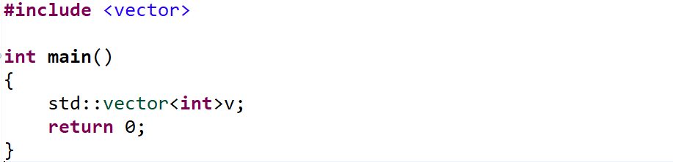
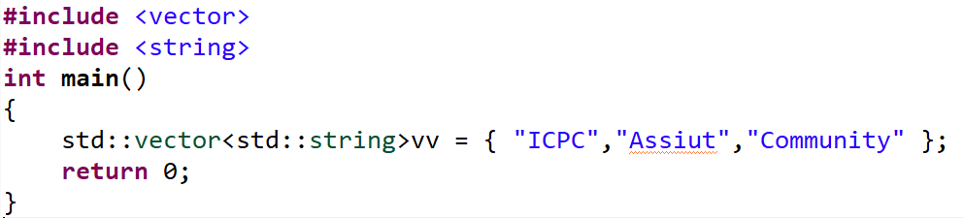
VECTOR Container in STL

Slide 9
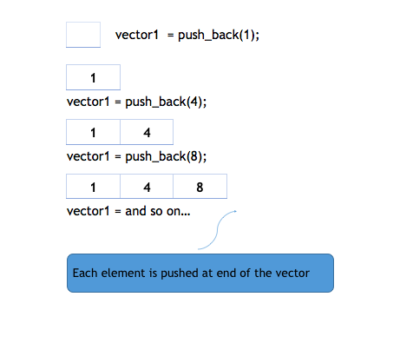
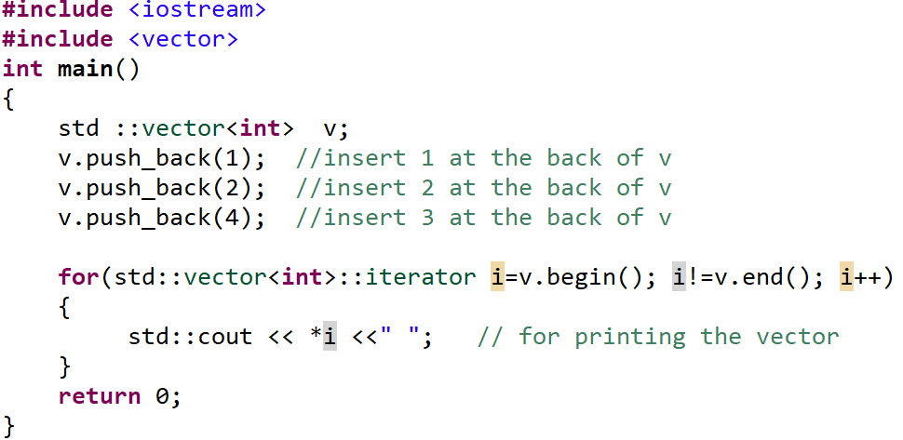
Member Functions of Vector
push_back function

Slide 10
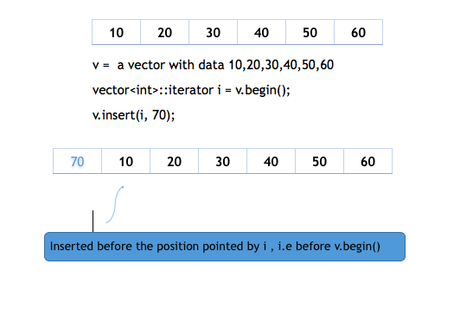
Member Functions of Vector
insert function

Slide 11
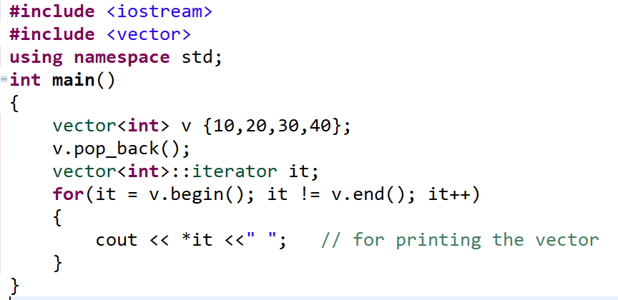
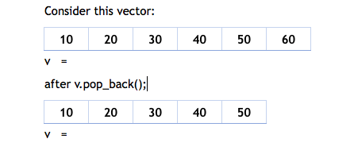
Member Functions of Vector
pop_back function

Slide 12
Member Functions of Vector
erase function
resize function
clear function
size function
empty function
front and back functions
Etc.. http://www.cplusplus.com/reference/vector/vector/

Slide 13

QUEUE Container in STL
عارف طابور العيش ؟!!

Slide 14
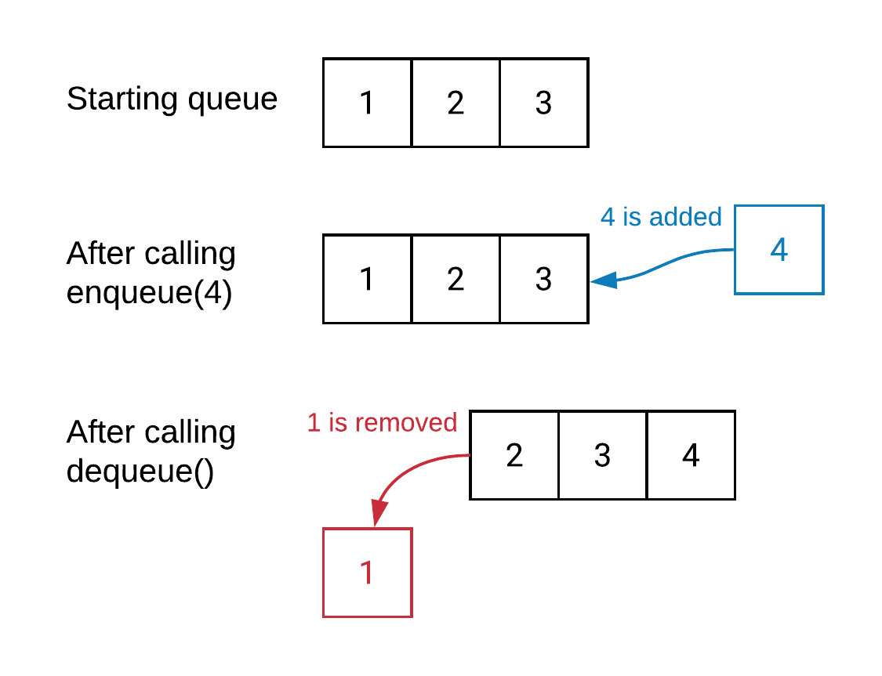
QUEUE Container in STL
declaration
push
pop
back // last
front // first
size
empty
iterate over it

Slide 15
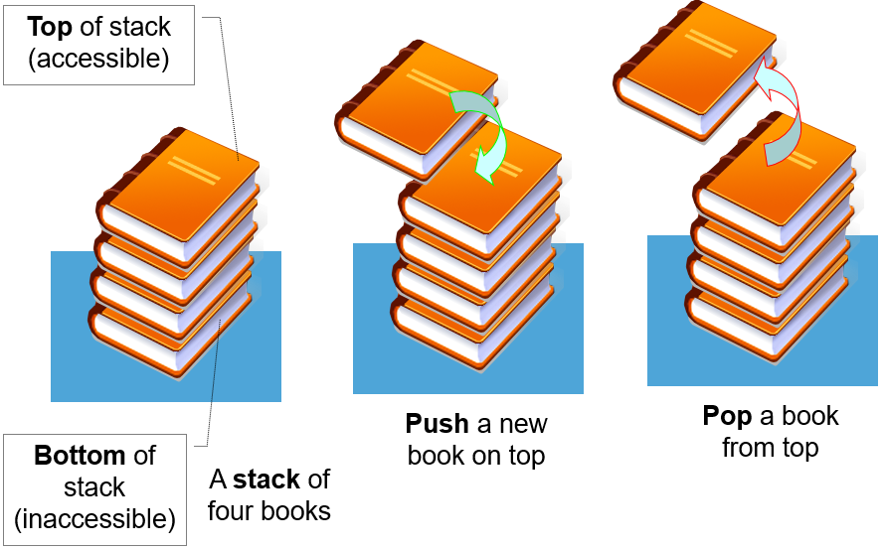
STACK Container in STL

Slide 16
STACK Container in STL
declaration
push
pop
top
size
empty
iterate over it

Slide 17
Problem
Given string contain ‘(‘ , ‘)’ check if this string is balanced or not.

Slide 18

تلاجة البيت شغالة بنظام ؟!!

Slide 19
Dequeue Container in STL
declaration
push_back
push_front
pop_back
pop_front
size
empty
clear
iterate over it

Slide 20
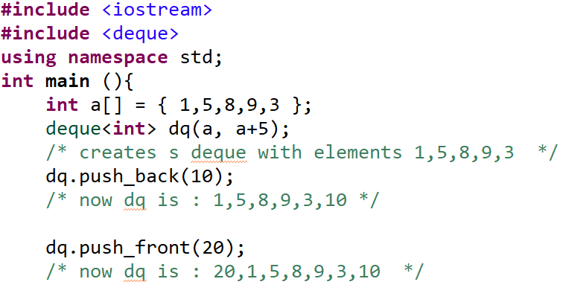
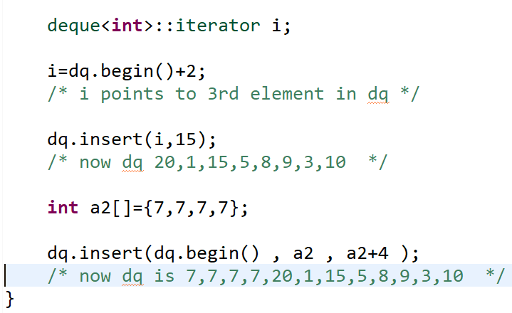
Dequeue Container in STL

Slide 21
Dequeue Container in STL

Slide 22
Dequeue Vs VECTOR
Deque is a shorthand for doubly ended queue. Deque allows fast insertion and deletion at both ends of the queue.
Although we can also use vector container for the insertion and deletion at both of its ends, but insertion and deletion at the front of the array is costlier than at the back, in case of deque but deque are more complex internally.

Slide 23
priority_queue Container in STL
Priority queues are a type of container adapters, specifically designed such that the first element of the queue is the greatest of all elements in the queue and elements are in non increasing order (hence we can see that each element of the queue has a priority {fixed order}).

Slide 24
priority_queue Container in STL
declaration
push
pop
top
size
empty
iterate over it

Slide 25
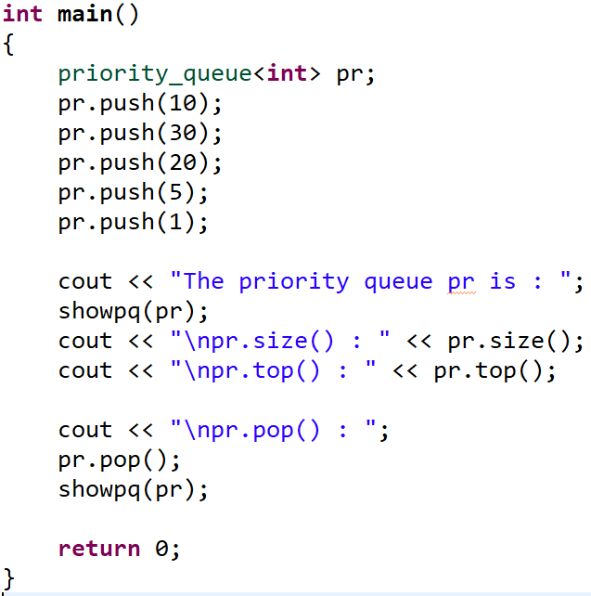
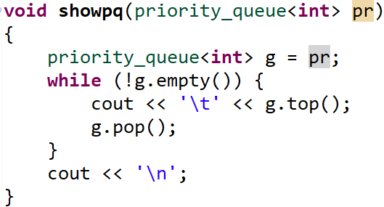
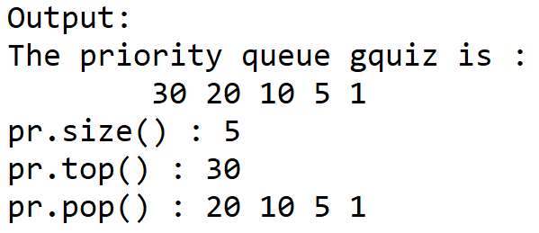
priority_queue Container in STL

Slide 26
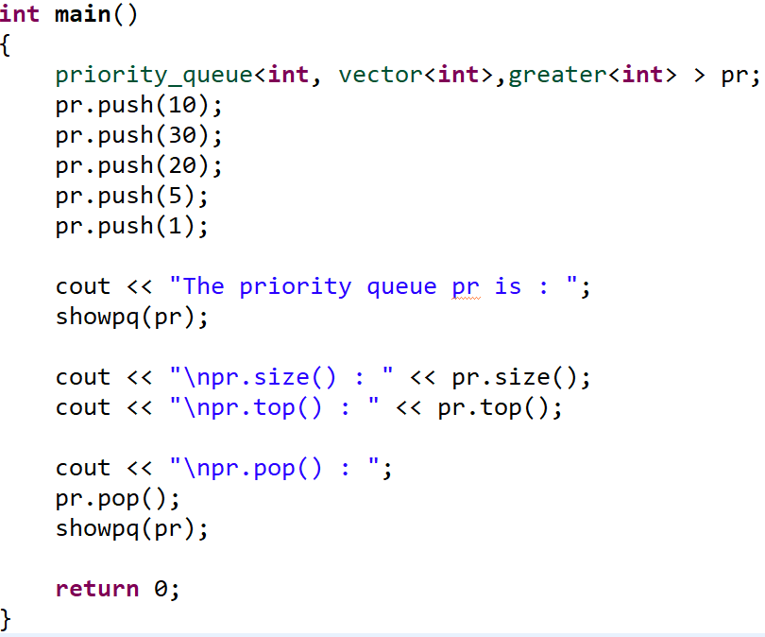
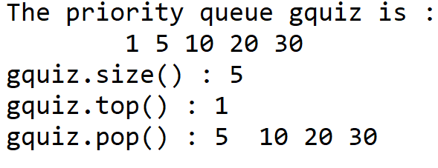
priority_queue Container in STL

Slide 27

ودلوقي جه دورك ^^
https://codeforces.com/group/c3FDl9EUi9/contest/263096/problem/G

Slide 28
Break.. Twenty game

Slide 29
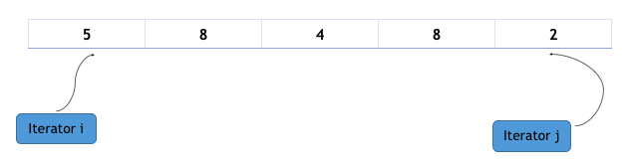
Overview of Iterators in C++ STL
Iterators are used to point to the containers in STL, because of iterators it is possible for an algorithm to manipulate different types of data structures/Containers.

Slide 30
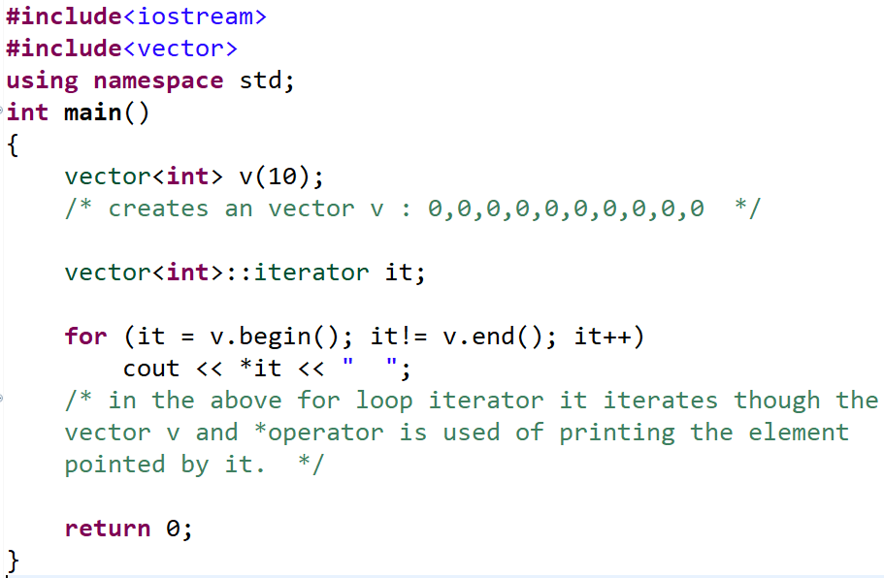
Overview of Iterators in C++ STL
Iterators can be used to traverse the container, and we can de-reference the iterator to get the value of the element it is pointing to. Here is an example:

Slide 31
Operations on Iterators in STL
Following are the operations that can be used with Iterators to perform various actions.
advance()
distance()
next()
prev()
begin()
end()

Slide 32
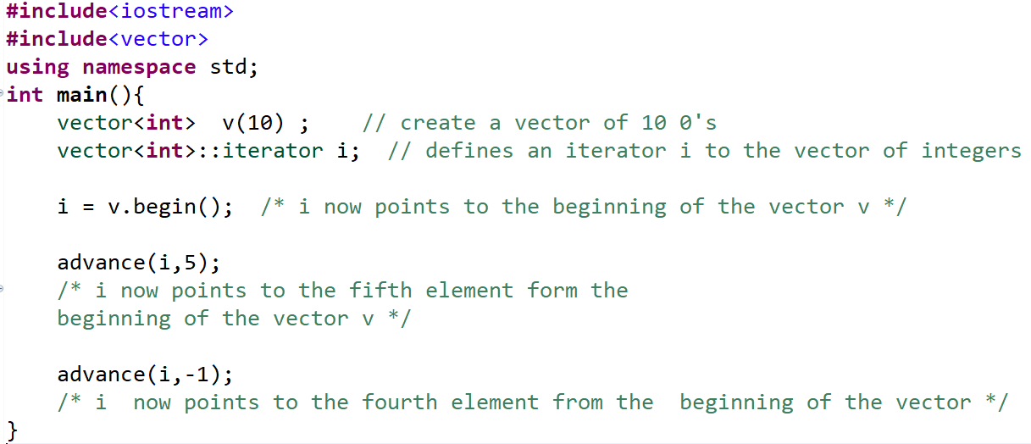
Operations on Iterators in STL advance() Operation
It will increment the iterator i by the value of the distance. If the value of distance is negative, then iterator will be decremented.

Slide 33
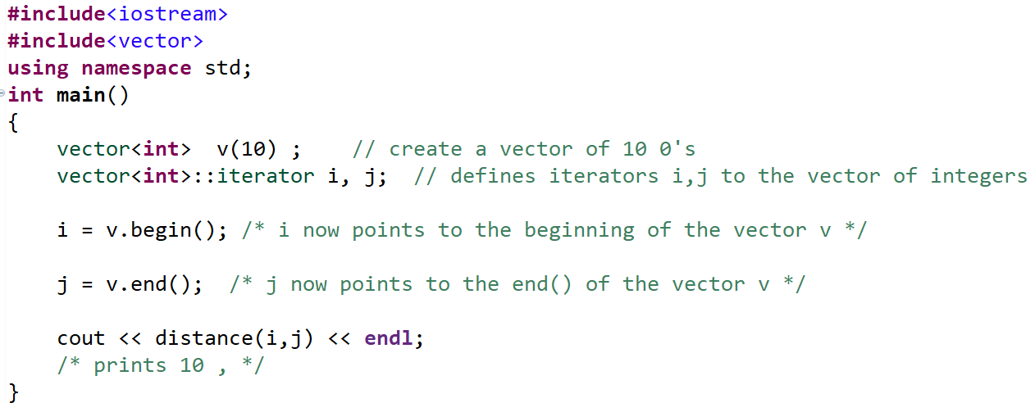
Operations on Iterators in STL distance() Operation
It will return the number of elements or we can say distance between the first and the last iterator.
.

Slide 34
Operations on Iterators in STL
next() Operation It will return the nth iterator to i, i.e iterator pointing to the nth element from the element pointed by i.
SYNTAX: next(iterator i ,int n)
prev() Operation It will return the nth predecessor to i, i.e iterator pointing to the nth predecessor element from the element pointed by i.
SYNTAX: prev(iterator i, int n)
begin() Operation this method returns an iterator to the start of the given container.
SYNTAX: begin()
end() Operation this method returns an iterator to the end of the given container.
SYNTAX: end()

Slide 35
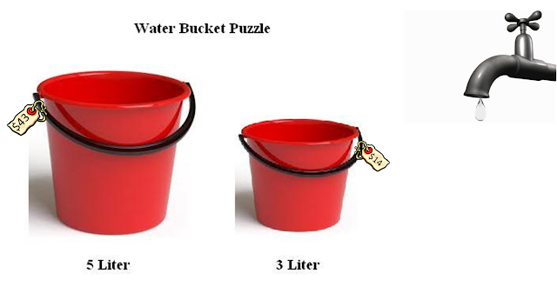
IQ question for interview?

Slide 36
Overview of Algorithms in C++ STL?
STL provide different types of algorithms that can be implemented upon any of the container with the help of iterators. Thus now we don’t have to define complex algorithm instead we just use the built in functions provided by the algorithm library in STL.
As already discussed earlier, algorithm functions provided by algorithm library works on the iterators, not on the containers. Thus one algorithm function can be used on any type of container.
Use of algorithms from STL saves time, effort, code and are very reliable.

Slide 37
Overview of Algorithms in C++ STL?
Sort
reverse
Count
binary_search ( details basic )
Lower_bound
Upper_bound
fill
max_element
next_permutation
prev_permutation
remove
Is_sorted
Code : https://ideone.com/rLWMpR

Slide 38

دورك بقي ..

Slide 39
Problems
Given an array , print all its permutations.
Given an array of N numbers and Q queries for each query you will be given number check if the number is in array or not

Slide 40

مع السلامة يا جون ^^

